Slide 1
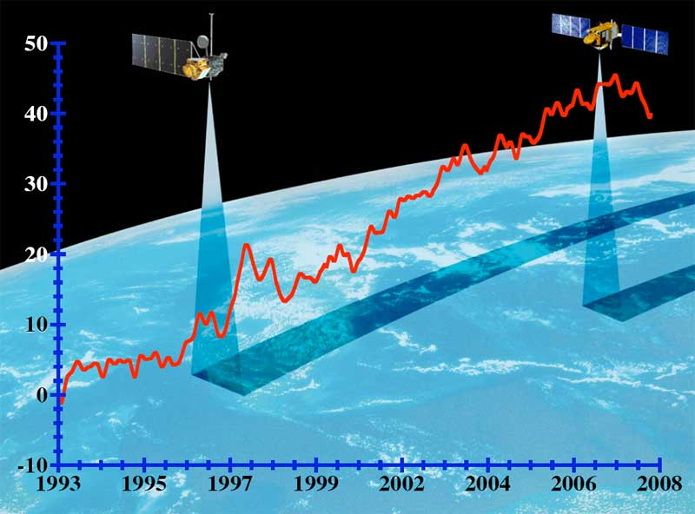
Module 3.9: Data Acquisition & Satellite Sensors
Lecture: Dr. Pham Duc Binh
Department of Space and Applications
Email: pham-duc.binh@usth.edu.vn

Slide 2
1. INTRODUCTION TO SATELLITE RADAR ALTIMETRY
Introduction to satellite radar altimetry
- History of satellite altimetry
How satellite altimetry works
- Basic principle
- From radar pulse to range
- Frequencies used and their impact
- High precision altimetry
3. Satellite altimetry missions
- Past missions
- Current missions
- Future missions
- Altimetry in planetary missions
4. Data flow
- Data acquisition
- Data processing
- Data qualification
5. Future improvement of satellite altimetry
- Ka-band altimetry
- Altimetry interferometry
- GNSS altimetry
6. Applications of satellite altimetry
- Ocean Applications
- Land & Sea Ice Applications
- Climate Applications
- Atmospheric Applications
- Hydrology & Land Applications
7. Tools to get the height variations of inland water bodies
8. Hand-on training using satellite altimetry for monitoring lake water volume

Slide 3
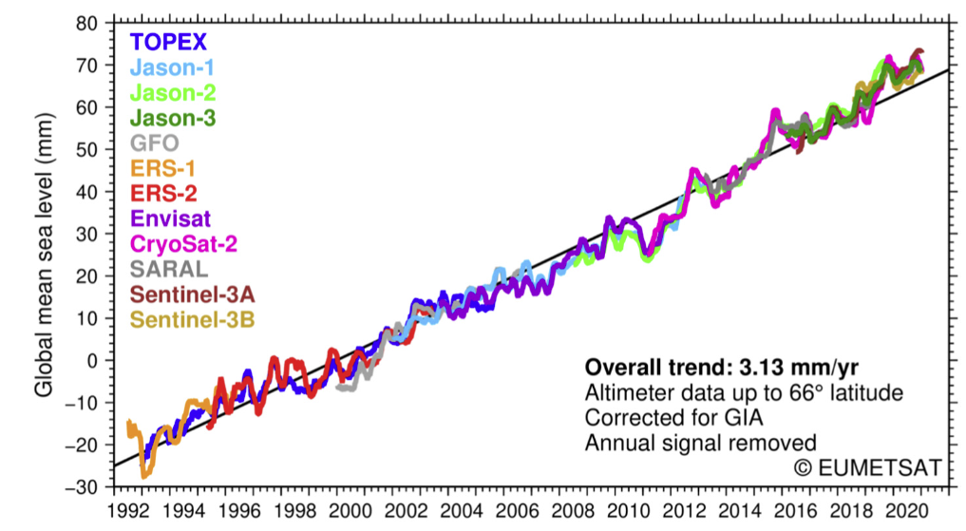
WHAT IS SATELLITE ALTIMETRY
Altimetry is a technique for measuring height.
Satellite altimetry measures the time taken by a radar pulse to travel from the satellite antenna to the surface and back to the satellite receiver. Combined with precise satellite location data, altimetry measurements yield sea-surface heights.
Altimetry was developed for oceanography, but then also found effective for inland hydrology
History of satellite altimeters
First altimeter flown on Skylab
Then Seasat launched in 1978, which lasted 90 days
GEOSAT Geodetic Mission (18 months from Mars 1985 to September 1986
GEOSAT Exact Repeat Mission (November 1986 to December 1989)
TOPEX/Poseidon launched 1992
Jason-1 (2001), Jason-2 (2008), and Jason-3 (2008)
GFO launched 1998
ERS-1 and ERS-2 launched in 1991 and 1995
ENVISAT launched in 2002
CryoSat-2 launched in 2010
SARAL launched in 2013
Sentinel-3A & B launched in 2016 and 2018

Slide 4
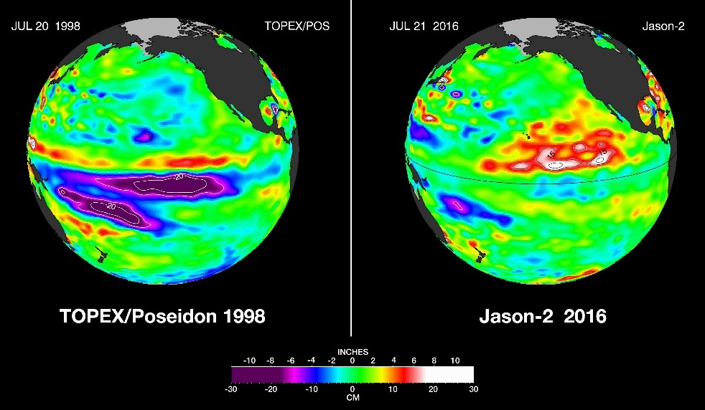
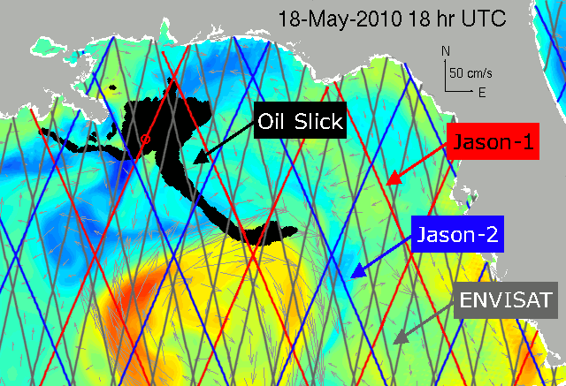
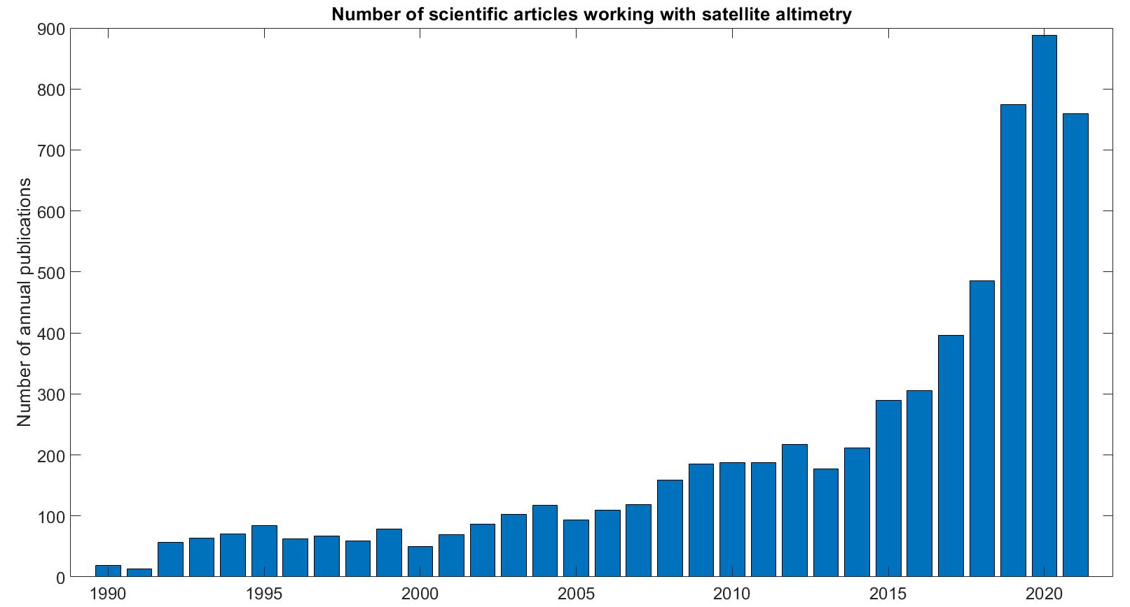
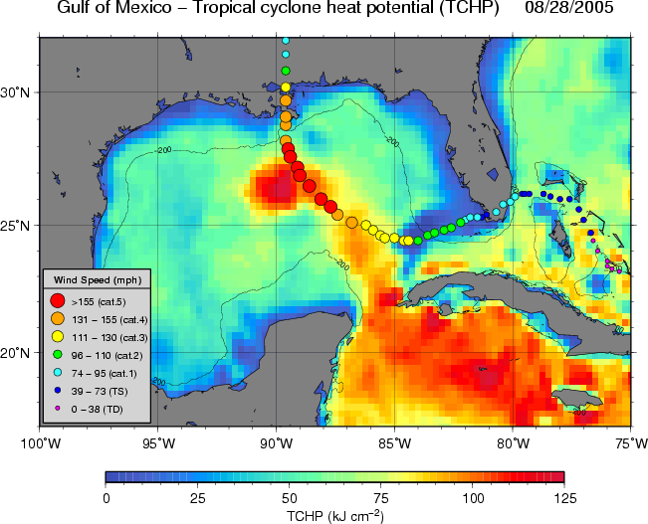
OTHER OCEANOGRAPHY APPLICATIONS
El Nino/La Nina Monitoring
Near Real Time Surface Currents
Credit: Josh K. Willis - JPL
Ocean Heat Content & Tropical Cyclones
Many scientific papers used satellite altimetry data

Slide 5
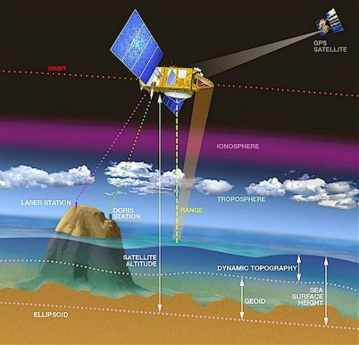
2. HOW SATELLITE RADAR ALTIMETRY WORKS?
Step 1: Satellite-to-surface distance (Range)
R = $\frac{c×t}{2}$
Where
R is satellite-to-surface distance
C is speed of light ($3×{10}^{8} m/s)$
t is the time taken to make the round trip between the satellite and the surface
However, as electromagnetic waves travel through the atmosphere, they can be decelerated by water vapor or ionization.
Once these phenomena have been corrected for, the final range can be estimated with great accuracy.
The ultimate aim is to measure surface height relative to a terrestrial reference frame.
This requires independent measurements of the satellite’s orbital trajectory, i.e. exact latitude, longitude and altitude coordinates.

Slide 6
2. HOW SATELLITE RADAR ALTIMETRY WORKS?
Step 2: Satellite Altitude (S)
The altitude of a satellite (S) is the satellite’s distance with respect to an arbitrary reference (e.g. the reference ellipsoid, a rough approximation of the Earth’s surface).
The satellite can be tracked in a number of ways so as to measure its altitude with the greatest possible accuracy and thus determine its precise orbit, accurate to within 1 or 2 cm.
The main techniques used are:
Doppler shift, to accurately determine the satellite’s velocity on its orbit, using dynamic orbitography models to deduce the satellite’s trajectory relative to Earth (e.g. DORIS, or PRARE instruments)
GPS or similar systems
Laser tracking, often for calibration.

Slide 7
2. HOW SATELLITE RADAR ALTIMETRY WORKS?
Step 3: Surface Height
The surface height (H), is the satellite’s distance at a given instant from the reference surface, so:
(corrected) Height = Satellite Altitude – (corrected) Range
H = S – R
For the calculation of the sea surface height (SSH) over the ocean, we need to take into account some effects:
The SSH without any perturbing factors (wind, currents, tides, etc.). This surface, known as the GEOID
The ocean circulation, or dynamic topography which comprises: the permanent stationary component (permanent circulation, permanent wind, etc.), and a highly variable component (due to wind, seasonal variations, etc.)

Slide 8
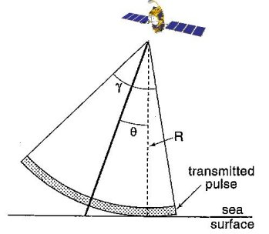
FROM RADAR PULSE TO RANGE
Satellite radar altimetry can be used to study the ocean, ice, and inland hydrology.
The best results are obtained over the ocean, which is spatially homogeneous and has a surface which conforms with known statistics.
Surfaces which are not homogeneous, which contain discontinuities or significant slopes, such as some land surfaces, make accurate interpretation more difficult. Even in the best case (the ocean), the pulse should last no longer than 70 picoseconds to achieve an accuracy of a few centimetres.
The altimeter transmits a short pulse of microwave radiation with known power toward the surface (13.575 Ghz for the Ku-band and 3.2 GHz for the S-band)
The altimeter emits pulses, but they are not narrow as with a laser, rather it leaves the antenna as a widening beam, getting wider the further it travels.
The pulse interacts with the rough surface and part of the incident radiation reflects back to the altimeter

Slide 9
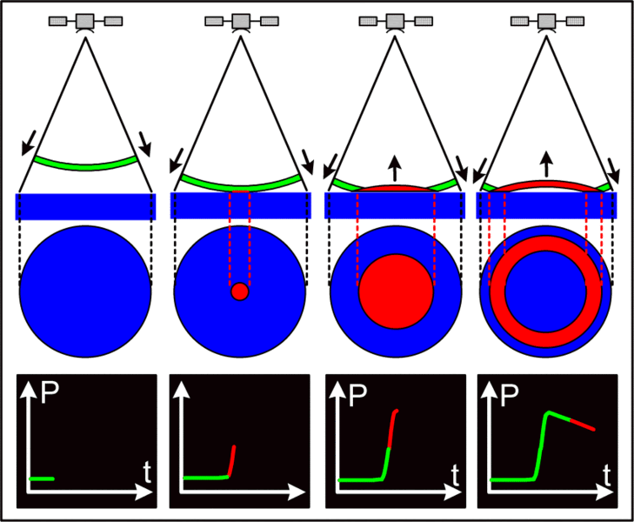
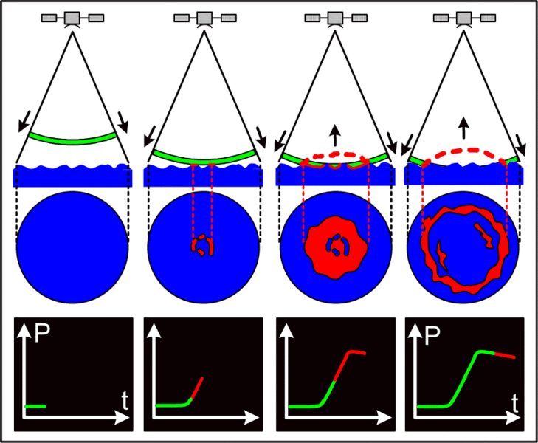
FROM RADAR PULSE TO RANGE
The radar altimeter receives the reflected wave (or echo), which varies in intensity over time. Where the sea surface is flat (left), the reflected wave’s amplitude increases sharply from the moment the leading edge of the radar signal strikes the surface. However, in sea swell or rough seas (right), the wave strikes the crest of one wave and then a series of other crests which cause the reflected wave’s amplitude to increase more gradually. We can derive ocean wave height from the information in this reflected wave since the slope of the curve representing its amplitude over time is proportional to wave height.

Slide 10
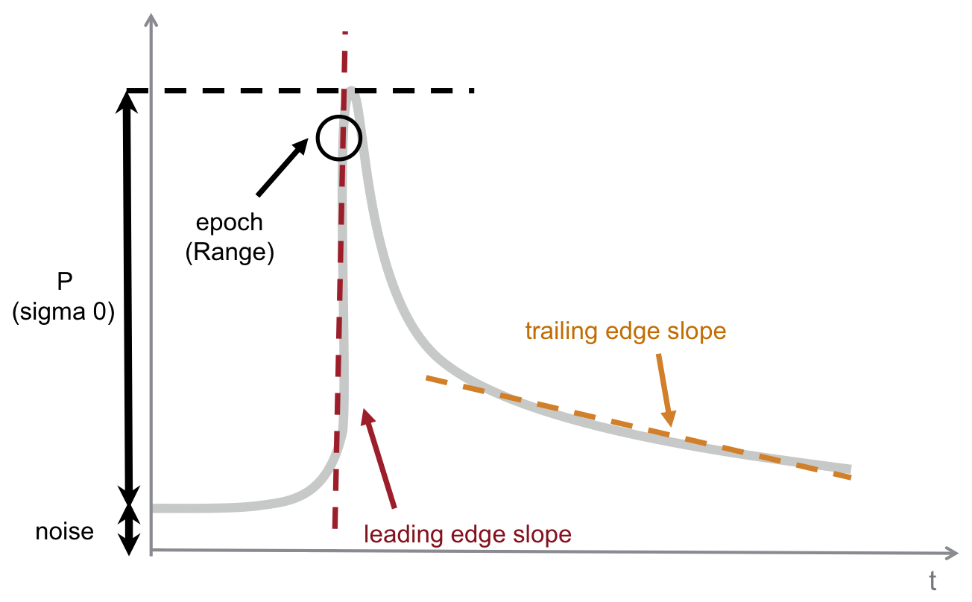
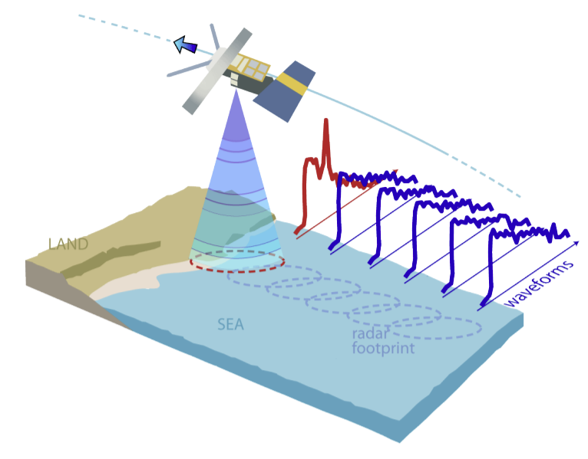
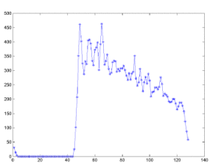
FROM RADAR PULSE TO RANGE
Waveform in reality
Waveform in Perfect Conditions
ENVISAT Waveform over the ocean

Slide 11
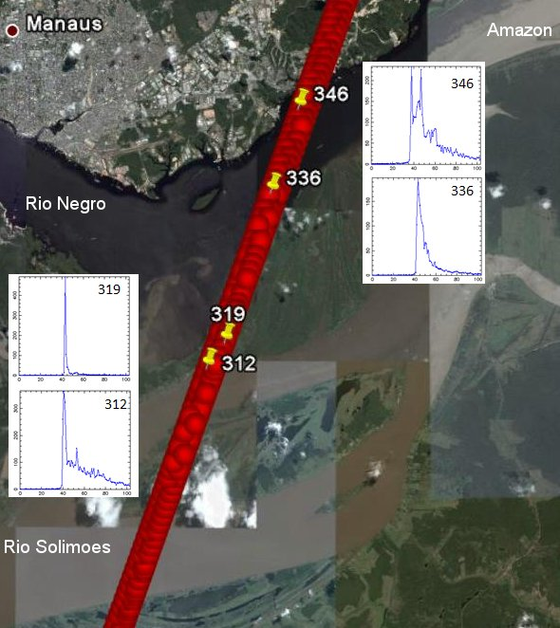
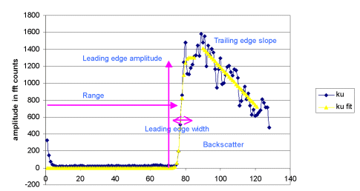
FROM RADAR PULSE TO RANGE
ENVISAT Waveform over inland water bodies
Jason-2 waveforms on Amazon river

Slide 12
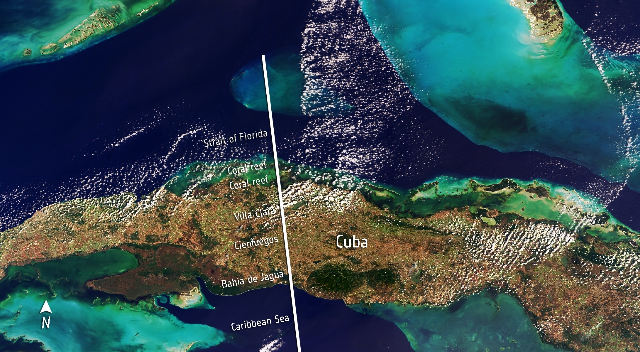
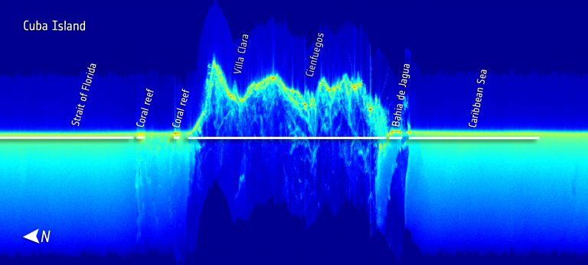
FROM RADAR PULSE TO RANGE
Examples of real waveforms (from the CryoSat-2 SIRAL altimeter), over the isle of Cuba

Slide 13
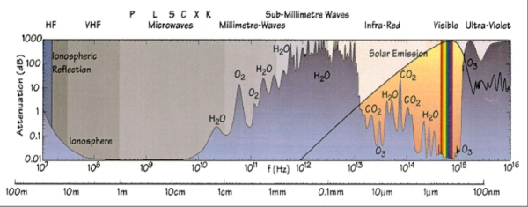
FREQUENCIES USED IN RADAR ALTIMETRY & THEIR IMPACTS
Electromagnetic Spectrum
Several different frequencies can be used for radar altimeters
The choice of the frequency depends on regulations, mission objectives and constraints, technical possibilities
Each frequency band has its advantages and disadvantages

Slide 14
FREQUENCIES USED IN RADAR ALTIMETRY & THEIR IMPACTS
K_{u} band, C band, S band and K_{a} band
K_{u} band (13.6 GHz): the most commonly-used frequency in radar altimeter (used for Topex/Poseidon, Jason-1, ENVISAT, ERS, etc). It is the best compromise between the capacities of the technology, the available bandwidth, sensitivity to atmospheric perturbations, and perturbation by ionospheric electrons.
C band (5.3 GHz): is more sensitive than K_{u} to ionospheric perturbation, and less sensitive to the effects of atmospheric liquid water. Its main function is to enable correction of the ionospheric delay in combination with the K_{u} band measurements.
S band (3.2 GHz): is also used in combination with the K_{u} band measurement, for the same reasons as the C band
K_{a} band (35 GHz): provides better observation of ice, rain, coastal zones, land masses, and wave height. This frequency provides higher resolution, especially near the coast. It is also better reflected on ice. However, attenuation due to water or water vapour is high, meaning that no measurement are produced when the rain rate is higher than 1.5 mm/h

Slide 15
FREQUENCIES USED IN RADAR ALTIMETRY & THEIR IMPACTS
Dual-frequency altimeters & Varying bandwidth
Dual-frequency altimeters: using two frequencies is a way to estimate the content of inospheric elections, thus correcting the altimeter range from the delay these electrons induce. Other uses of these two simultaneous measurement can be done, such as estimation of rain rates.
A varying bandwidth: The Envisat satellite has three different bandwidths for the same central K_{u}-band frequency. Each bandwidth corresponds to a proper resolution. The higher the bandwidth, the better the resolution.
a 320 MHz bandwidth with resolution of 47 cm
a 80 MHz bandwidth with resolution of 190 cm
a 20 MHz bandwidth with resolution of 750 cm

Slide 16
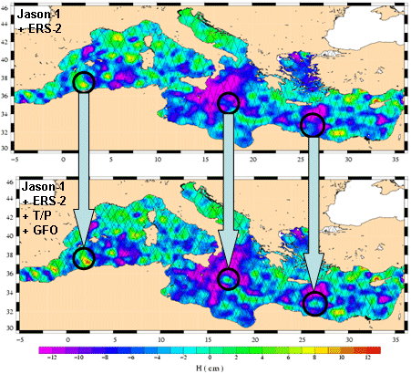
ALTIMETER CONSTELLATIONS
The coverage of only one satellite is limited. However, we can combine information collected from several satellites to improve quality of our estimation.
Sea level anomaly maps over the Mediterranean from 11 June 2003, made from Jason-1 + ERS-2 (top) and Jason-1+ERS-2+T/P+GFO (bottom). Merging the data from the four satellites shows spots that are invisible, or barely visible with two satellites and much better resolved with four.

Slide 17
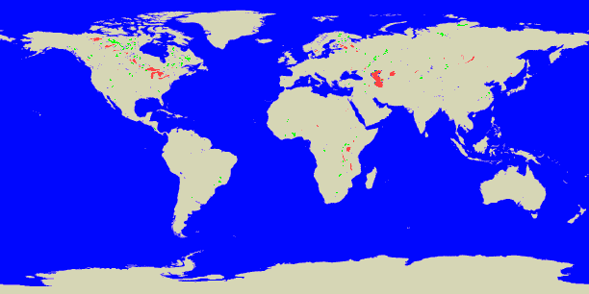
ALTIMETER CONSTELLATIONS
Number of lakes seen by ERS (or Envisat) (215 lakes of more than 100 km² - blue) and Topex/Poseidon (43 lakes - red). Combining the two satellites, we can observe variation of more lakes.

Slide 18
3. SATELLITE ALTIMETRY MISSIONS
Past missions:
- Skylab
- GEOS 3
- Seasat
- Geosat
- ERS-1
- Topex/Poseidon
- Geosat Follow-on
- ERS-2
- Envisat
- Jason-1
Current missions:
- Jason-2
- Cryosat-2
- HaiYang-2
- Saral
- Jason-3
- Sentinel-3
- Jason-CS/Sentinel-6
Future missions:
- SWOT
Altimetry in planetary missions
- MARSIS – Mars
- SHARAD – Mars
- RIME – Jupiter Moons
- SRS - Venus

Slide 19
3. SATELLITE ALTIMETRY MISSIONS
Past missions:
- Skylab
- GEOS 3
- Seasat
- Geosat
- ERS-1
- Topex/Poseidon
- Geosat Follow-on
- ERS-2
- Envisat
- Jason-1

Slide 20
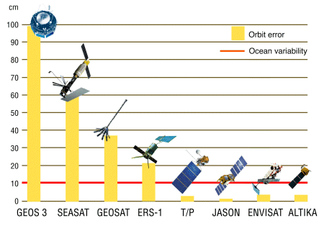
PAST MISSIONS

Slide 21
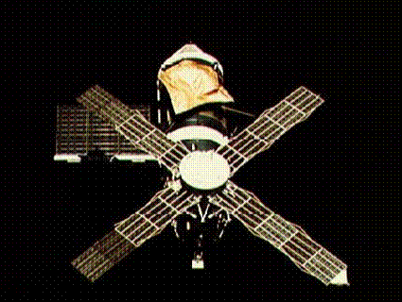
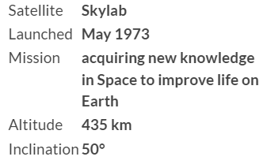
PAST MISSIONS
Skylab was the first American experimental Space station, launched in May 1973, and visited by crews three times in 1973 and 1974.
The satellite was equipped with both active and passive microwave measurement systems called S193. This instrument carried the first spaceborne altimeter, for the purpose of “to providing ocean state effects on pulse characteristics”.
The satellite only operated over short orbital segments only, but was able to demonstrate the measurement of coarse features of the marine geoid, such as major ocean trenches.

Slide 22
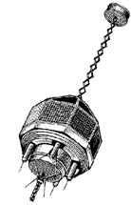
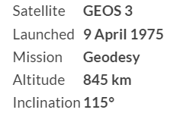
PAST MISSIONS
GEOS 3 – Geodynamics Experimental Ocean Satellite – was launched in April 1975, and ended its mission in December 1978. It carried the first instrument to yield measurement of sea level and its variability over time.
GEOS 3 offered significant improvement over Skylab’s altimeter, including improved performance as well as greater global coverage, but this performance was still not good enough to enable useful science to be extracted from its measurements.

Slide 23
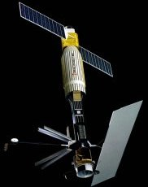
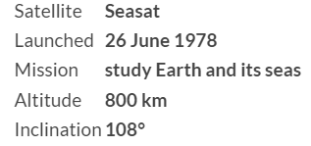
PAST MISSIONS
Seasat – SEAfaring SATellite – was launched in June 1978, and ended its mission in October 1978, due to malfunction.
Important instruments on-board of the satellite:
- A synthetic aperture radar which provided the first ever highly-detailed radar images of ocean and land surfaces from Space
- A radar scatterometer which measured near-surface wind speed and direction
- A radar altimeter which measured ocean surface and wave height
- A scanning multi-channel microwave radiometer which measured surface temperatures, wind speeds and sea ice cover
- A high-performance altimeter firstly designed for remote sensing of the oceans

Slide 24
PAST MISSIONS
From Seasat, a new approach was used for satellite radar altimeter – the full-deramp technique – since then, all radar altimeters have been using this technique, achieving a significant improvement in resolution.
Seasat provided the first global view of ocean circulation, waves and winds, providing new insights into the links between the ocean and atmosphere.
For the first time, the state of an entire ocean could be seen at once.
Seasat’s altimeter mapped ocean topography, allowing us to determine ocean circulation and heat storage.
Since Seasat, advance ocean altimeters on the next satellites have been making precise measurements of sea surface height which are used to study climate phenomena such as El Nino and La Nina.
Ocean altimetry has since become part of weather and climate models and many other applications.

Slide 25
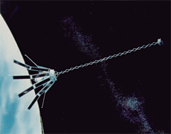
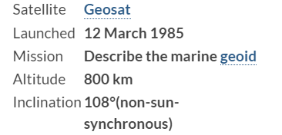
PAST MISSIONS
Geosat – GEOdetic SATellite – was launched in March 1985, and ended its mission in January 1990.
Its primary task was to measure the marine geoid for the US Navy, but also to provide measurements of sea state and winds.
When its 18-month mission was over, the satellite was put on a 17-day repeat orbit which began on 8 November 1986, retracing Seasat’s ground tracks, and providing altimetry data to the scientific community over three years.
Geosat was the first mission ever to provide long-term high-quality altimetry data.

Slide 26
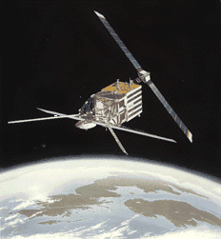
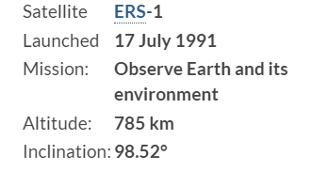
PAST MISSIONS
The ERS-1 – European Remote-Sensing Satellite-1 – was launched in July 1991, switched off in June 1996 and retired in March 2000.
The satellite’s main mission was to observe the Earth’s atmosphere and ocean.
Among several carried instruments, there was a radar altimeter, which works in three different orbits:
- A 3-day period for calibration and sea ice observation
- A 35-day period for multi-disciplinary ocean observations
- A 168-day period for geodetic applications

Slide 27
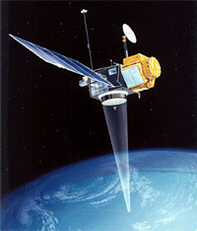
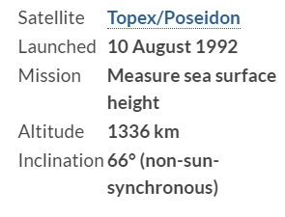
PAST MISSIONS
The Topex/Poseidon satellite – a joint project between NASA and CNES – was launched in August 1992, with the objective of “Observing and understanding the ocean circulation”.
The satellite carried two radar altimeters and precise orbit determination systems, including the DORIS system.
The satellite supplied the world’s ocean topography, or sea surface height, every ten days
This mission ended in January 2006, due to a failure of the reaction wheel.
The former Topex/Poseidon ground tracks was then applied to Jason-1 satellite.

Slide 28
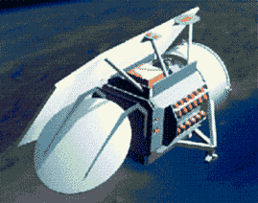
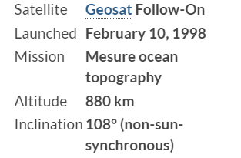
PAST MISSIONS
The Geosat Follow-On (GFO) satellite was launched in February 1998, and retired in November 2008.
The GEO satellite follows the 17-day repetitive orbit of the Geosat.
GEO’s mission is to provide real-time ocean topography data to the US Navy using a radar altimeter.
Scientific and commercial users have access to these data through the National Oceanic and Atmospheric Administration (NOAA).

Slide 29
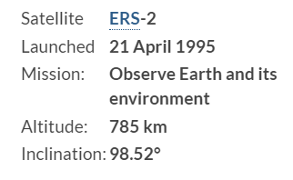
PAST MISSIONS
The European Remote-Sensing Satellite-2 was launched in April 1995 as the follow-on from ERS-1, with the mission to observe atmosphere and ocean using a radar altimeter.
ERS-2 used the identical orbits with ERS-1, with a one-day shift.
The satellite ended its mission in July 2011.

Slide 30
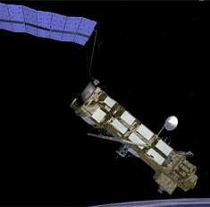
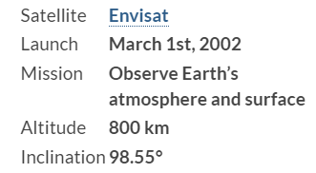
PAST MISSIONS
The Environmental Satellite (Envisat) is the follow-on to ERS-1 and ERS-2, designed for environmental studies, and climate change by observing the Earth’s atmosphere and surface.
Among 10 instruments, there is a radar altimeter and a DORIS orbitography and precise location system.
Similar to ERS-2, Envisat’s orbital period is 35 days.
In October 2010, Envisat changed its orbit to ensure an additional 3 years lifespan. As a result, its ground tracks changed, as well as its repeat cycle, to 30 days with 431 orbits per cycle instead of 35 days with 501 orbits per cycle.

Slide 31
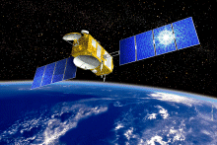
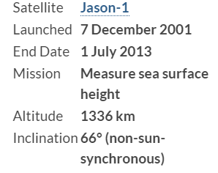
PAST MISSIONS
The Jason-1 satellite is the follow-on to Topex/Poseidon, was launched in December 2001, and terminated in July 2013 due to the lost of communication with the satellite.
The main objective of this mission is to observe variation of sea surface height (SSH) accurately to within a few centimeters all over the globe.

Slide 32
3. SATELLITE ALTIMETRY MISSIONS
Current missions:
- Jason-2
- Cryosat-2
- HaiYang-2
- Saral
- Jason-3
- Sentinel-3
- Jason-CS/Sentinel-6

Slide 33
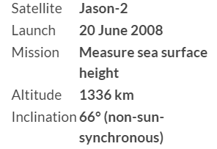
CURRENT MISSIONS
The Jason-2 satellite is taking over and continuing the missions of Topex/Poseidon and Jason-1.
Jason-2 carries the same kind of payloads as its two predecessors for a high-precision altimetry mission.
The Jason-2 payload includes the next generation of Poseidon altimeter, but with a lower instrument noise, and a DORIS location system.
The accuracy should be about 2.5 cm for the altimeter measurements.

Slide 34
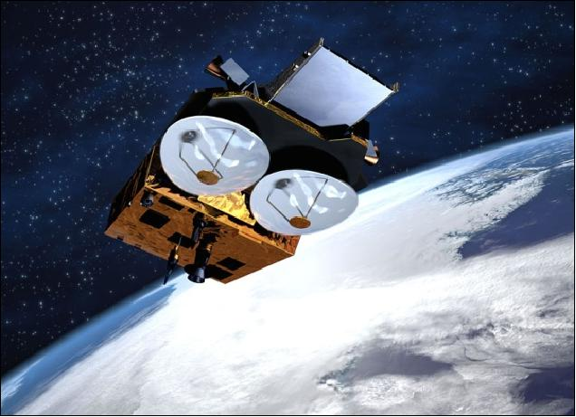
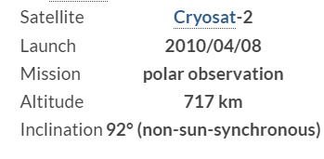
CURRENT MISSIONS
The Cryosat-2, launched in April 2021, is an altimetry satellite designed to observe the polar.
It embarks on a three-and-a-half-year mission to determine variations in the thickness of the Earth’s continental ice sheets and marine ice cover, and to test the prediction of thinning Arctic ice due to global warming.
Currently, Cryosat-2 is operating over the oceans for validation purposes in low-resolution mode.
The first Cryosat satellite was lost on launch in October 2005, due to an anomaly in the launch sequence.

Slide 35
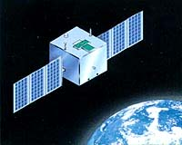
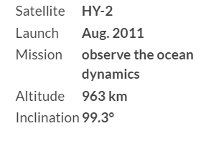
CURRENT MISSIONS
HaiYang-2 (meaning “ocean” in Chinese) is a marine remote sensing satellite series planned by China, launched in August 2011.
The main objective of HY-2 is to monitor the dynamic ocean environment with microwave sensors to detect sea surface wind field, sea surface height (SSH), and sea surface temperature (SST).
The satellite includes an altimeter dual-frequency in Ku and C-bands, a scatterometer and a microwave imager.

Slide 36
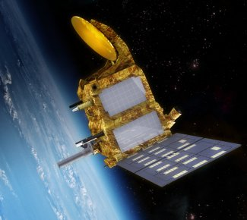
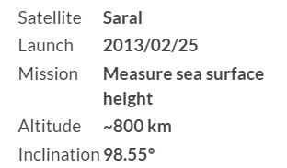
CURRENT MISSIONS
Saral – Satellite with Argos and Altika – is a joint project between the Indian Space Research Organization (ISRO) and CNES.
The satellite was launched in February 2013 with the objective to enable better observations of ice, rain, coastal zones, land masses (forest, etc.), and wave height.
The proposed payload includes:
- A high-resolution AltiKa altimeter
- A DORIS precise orbitography system, in association with a laser retroreflector

Slide 37
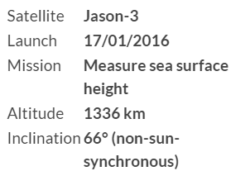
CURRENT MISSIONS
Jason-3 – launched in January 2016 – is proposed to take over and continue the mission of Topex/Poseidon, Jason-1 and 2.
The satellite carries the same kind of payload as its three predecessors for a high-precision altimetry missions, including a Poseidon-class altimeter, a radiometer and three location systems.
Jason-3’s orbit is also identical to its three predecessors.

Slide 38
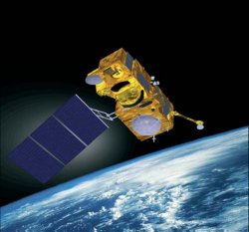
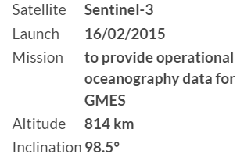
CURRENT MISSIONS
Sentinel-3 satellite – launched in February 2015 – was designed for providing operational oceanographic services that have been developed with ERS and Envisat satellites since 1991.
The Sentinel-3 altimetry mission complements the Jason series to contribute to a worldwide operational oceanographic service.
Sentinel-3 carries a suite of cutting edge instruments to measure sea surface temperature, sea colour, and sea surface topography.

Slide 39
CURRENT MISSIONS
Jason-CS/Sentinel-6 – launched in November 2020 – is designed to ensure adequate overlap with Jason-3 in a joint project between NASA and ESA.
The satellite carries a Poseidon-4 radar altimeter and a microwave radiometer for the mission of providing sea surface height measurements until at least 2030.

Slide 40
3. SATELLITE ALTIMETRY MISSIONS
Future missions:
- SWOT
Altimetry in planetary missions
- MARSIS – Mars
- SHARAD – Mars
- RIME – Jupiter Moons
- SRS - Venus

Slide 41
FUTURE MISSIONS
The Surface Water and Ocean Topography (SWOT) mission will be launched at the end of 2022.
This is the NASA’s first global survey of Earth’s surface water.
SWOT will observe major lakes, rivers and wetlands while detecting ocean features, providing information that is needed to assess water resources on land, track regional sea level changes, monitoring coastal processes, and observe small-scale ocenan currents.

Slide 42
PLANETARY MISSIONS
SHARAD (SHAllow-RADar) is one of the main instruments on board the Mars Reconnaissance Orbiter (MRO), NASA’s planetary exploration spacecraft launched in August 2005 and operating in Mars’ orbit since the end of 2006. The purpose of the MRO mission is global mapping of the surface (in visible and near infrared), investigation of the subsurface, identification of future landing sites for spacecraft and future communications and navigation support to Martian missions.
Altitude: 250 – 316 km; Inclination: 93⁰
The MARSIS (Mars Advanced Radar for Subsurface and Ionosphere Sounding) orbital radar sounder, onboard ESA’s Mars Express spacecraft launched on 2 June 2003, was designed to investigate the Martian ionosphere and the geological and hydrological structure of the subsurface, with a particular emphasis on the detection of deep bodies of solid or liquid water.
Altitude: 298 – 10107 km; Inclination: 86.3⁰

Slide 43
PLANETARY MISSIONS
In May 2012 the European Space Agency approved the JUpiter ICy moons Explorer (JUICE) mission.
This is the first Large-class mission chosen as part of the ESA’s Cosmic Vision 2015-2025 programme.
JUICE is aimed to study Jupiter and to investigate the potentially habitable zones in the Galilean icy satellites: Ganymede, Europa, and Callisto.
One of the most important sets of science goals for JUICE is related to the study of the subsurface geology and geophysics of icy moons and to detect possible subsurface water.
RIME (Radar for Icy moon Exploration) is a radar sounder optimized for the penetration of the Galilean icy moons, Ganymede, Europa, and Callisto, up to a depth of 9 km.
This is a nadir-looking active instrument which transmits radio waves with the unique capability to penetrate deeply into the subsurface.
The satellite is expected to be launched in 2022

Slide 44
PLANETARY MISSIONS
EnVision is a proposed ESA medium-class mission to determine the nature and current state of geological activity on Venus, and its relationship with the atmosphere, to understand how Venus and Earth could have evolved so differently.
It will use a subsurface radar sounder to obtain profiles of the upper few hundred metres, and an IR mapper and spectrometer to detect volcanic eruptions and a world-leading European phased array synthetic aperture radar, VenSAR, to obtain global topography at 27m and imagery at up to 1m resolution, and us InSAR to detect changes of < 1cm/yr
The satellite is expected to be launched in 2029

Slide 45
4. DATA FLOW

Slide 46
DATA ACQUISITION
Data acquisition from the different altimetry satellites is performed by each agency. Several ground stations exist around the world (e.g. Kiruna, Sweden for the European Space Agency, Aussaguel, France for CNES, Poker Flats and Wallops for NASA, etc). They collect raw data from the satellites and send them to the control and processing centers.
Altimetry data processing also demands several external datasets, in particular to deal with the corrections required for processing the highest quality data.

Slide 47
KIRUNA GROUND STATION - SWEDEN
Kiruna hosts one 15- and one 13-m antenna. Both operate in S-band for uplink and downlink and X-band for downlink. The station is located at Salmijärvi, 38 km east of Kiruna, in northern Sweden.

Slide 48
DATA PROCESSING
Data processing is to transform raw altimetry data into an easily usable form.
Numerous elements are included in altimetry data, and classic altimetry data processing includes:
- Altimeter measurements
- Orbit determination
- Geophysical corrections
- Instrumental errors
- Reference surfaces
- Flags
- Retracking
- High-level processing

Slide 49
Altimetry Measurements

Slide 50
Orbit Determination
The ability to precisely determine a satellite’s position on orbit is a key factor in the quality of altimetry data.
Different products require different level of accuracy. Expected accuracy is 20 cm rms for 3-hours data, 2.5 cm rms for 3-day data, and 1.5 cm for 30-day data. The ultimate aim is to achieve centimeter accuracy.
Several factors to be considered for satellite’s orbit determination
- High-altitude orbit helps to attenuate the effects of the Earth’s gravity, which are not known with great accuracy for lower orbits. However, higher orbits require more power for the radar emission, in order to get back a strong enough signal, and it is more vulnerable to solar winds and cosmic particles.
- The orbit must not be too close to the poles, because the Earth’s gravity is less well understood there. However, to observe as much ocean as possible, an orbit close to the poles will be required.
- A high revisit capability is in order, to enable ocean signals to be observed
- Inclination: 90⁰ indicates a polar orbit => important to study the polar ice, or 66⁰ implies that the orbits sample from 66⁰N to 66⁰S => cover most of the world’s oceans.
- Type of orbits: sun-synchronous, non-sun-synchronous, geosynchronous, or geostationary
When the satellite is on its orbits, it is also important to maintain its orbits so that the deviation of the actual ground track from the nominal one is kept below 1 km, and the mean local crossing time matches the nominal one better than to within five minutes.

Slide 51
Geosynchronous & Geostationary orbits

Slide 52
Corrections
Geophysical Corrections
- Ocean tides: corrections of SSH variations due to the attraction of the Sun and Moon
- Solid earth tides: corrections of solid earth variations due to the attraction of the Sun and Moon
- Pole tides: corrections for variations due to the attraction of the Sun and Moon
- Tidal loading: corrections of height variation due to changes in tide-induced forces acting on the Earth’s surface
Propagation Corrections
- Ionosphere: correction of delay in the radar return signal due to the atmosphere’s electron content.
- Wet troposphere: correction of delay in the radar return signal due to cloud liquid water and water vapour
- Dry troposphere: correction of delay in the radar return signal due to dry gases in the atmosphere
Surface Corrections
- Inverse barometer: correction for variations in SSH due to atmosphere pressure variations
- Electromagnetic bias: corrections for bias in measurement caused by electromagnetic
Instrument Corrections: tracker bias, antenna gain pattern, …

Slide 53
Reference Surfaces

Slide 54
Reference Surfaces

Slide 55
DATA QUALIFICATION
Data qualification involves a series of quality control steps designed to ensure a continuous supply of data.
These steps have been controlled by Calval teams (CALibration/VALidation)
Calibration phase: This phase is conducted to make sure that the satellite’s outputs are in good quality, before being used by final users.
- Absolute calibration: comparing engineering measurement with an independent measurement of the same parameter (range, SSH …)
- Relative calibration: products derived from two altimetry systems are compared
- Relative calibration is significantly more precise than absolute calibration
- Altimetric measurement time series, being produced from different altimetric mission, needed to be inter-calibrated to remove bias between satellites
- Cross calibration includes product validation and algorithm verification
Data exploitation: This phase begins after the Calibration phase and continues until the end of the altimetry mission. During this phase, long-term altimeter range, SWH, and other parameters are monitored and further comparisons are made with in situ gauge data or other altimetry missions to give a consistent time series for all the altimetry missions.

Slide 56
5. FUTURE IMPROVEMENT OF SATELLITE ALTIMERY
Future satellite altimetry missions will need to provide better spatial and temporal coverage we can study mesoscale variations and other phenomena more closely.
Improvement can been made on the followings points:
- Using Ka-band altimeter
- Using altimeter-interferometers
- Using satellite constellations
- Using GNSS altimetry

Slide 57
Ka-band altimetry
Altimeter working at Ka-band (35 GHz) altimeter would be much less affected by the ionosphere than at Ku-band (12 – 18 GHz), and would have enhanced performance in terms of vertical resolution, time decorrelation of echoes, spatial resolution and range noise.
Ka-band electromagnetic waves are sensitive to rain, but this does not prevent them from acquiring a fairly high percentage of measurements, except for strong rain rates. This is a major drawback of Ka-band because of its attenuation due to water or water vapour in the troposphere is high. If the rain rate is higher than 1.5mm/h, the radar echoes will be unstable (whereas at Ku-band, echoes are hardly affected at rain rates less than 3mm/h).
Other benefits of using Ka-band for a satellite altimeter:
- Lower ionospheric attenuation
- Higher pulse repetition frequency => help to increase significantly the number of independent echoes per second compared with Ku-band altimeters
- Larger bandwidth (up to 500 MHz) => providing a high vertical resolution
- Better description of sea surface roughness than at Ku-band because of smaller wavelength of Ka-band (8 mm) => reduce noise and increase accuracy
- Lower radar penetration of snow and ice (penetration of snowpack is less than one centimeter at Ka-band, compared with five meters at Ku-band)

Slide 58
Altimeter Interferometer
The main limitations of standard nadir-pointing radar altimeters have been understood for a long time: lack of coverage (maximum 150 km for the T/P and Jason satellites) and the spatial resolution (2 km for T/P and Jason) => a limiting factor for the determination of mesoscale phenomena in the deep ocean.
=> Using off-nadir radar interferometry have been proposed to provide a solution in future missions
An altimeter/interferometer would work as follow: each interferometer would send out and receive back a wave from the others

Slide 59
Altimeter Interferometer equipped on board of the SWOT missions

Slide 60
Satellite Constellations
Another way to improve altimetry resolution is to use several satellites at the same time. However, until now, this has been done with very different types of satellites. The use of several identical satellites in constellation could reduce development costs and launch costs.
The questions to be solved relate to the minimum number of satellites needed, their distribution in time and space, etc. The answers will depend in part on the applications, and on the financing available
The WITTEX (Water Inclination Topography and Technology Experiment) altimetry satellite constellation project
GANDER (Global Altimeter Network Designed to Evaluate Risk) constellation of microsats in 2 orbit planes

Slide 61
GNSS Altimetry
One approach is to use GNSS/GPS/Galileo satellites and a satellite (receiver) on a low-earth orbit (400 – 500 km) retrieving signals emitted by multiple satellites and reflected by the ocean surface, then analyzing to compute SSH. The concept is still only in the study phase.
The concept works as follow:
The GPS receiver receives a signal downlinked from a satellite in the constellation, then receives the return echo of the same signal reflected by the ocean. By measuring the delay between the two signals, we can calculate the SSH.
Weakness: accuracy since the SSH error would be several meters. The only way to improve accuracy would be to retrieve more return echoes by increasing the number of GNSS/GPS/Galileo satellites.
Advantage: a low cost project.

Slide 62
6. APPLICATIONS OF SATELLITE ALTIMETRY DATA
Ocean Applications
Land and Sea Ice Applications
Climate Applications
Coastal Applications
Atmospheric Applications
Hydrology and Land Applications

Slide 63
OCEAN APPLICATIONS – OCEAN CURRENTS
The ocean is the surface studied by the majority of altimetry applications, and some missions are even optimised for it.
Ocean currents are sometimes compared to ‘sea highways’, because ships follow their flow to gain speed.
Standard deviation of ocean currents computed from 12 years of altimetry data (all available satellites during the 1992-2004 period) (Credits Aviso)

Slide 64
OCEAN APPLICATIONS – OPERATIONAL OCEANOGRAPHY
Jason-1 data only
Jason-1, ERS-2 and GFO data
Sea level anomalies on 8 January 2003 from the medium-resolution Mercator model (1/3°), with assimilation of in situ SST measurements and (left) Jason-1 data only, (right) all available altimetry satellite data (Jason-1, ERS-2 and GFO). More detail can be seen in the right-hand figure. (Credits Mercator Ocean)

Slide 65
OCEAN APPLICATIONS – OPERATIONAL OCEANOGRAPHY
Results derived from satellite altimetry can be used as input for global models to calculate the Sea Surface Temperature.
Sea Surface Temperature computed by the Mercator global model. (Credits Mercator Ocean)

Slide 66
OCEAN APPLICATIONS – TIDES
Tides have been studied for longer than most other ocean phenomena; however, for most of this time, the only measurements possible were those made by tide gauges on the coasts, mostly in harbours, which were thus subject to local factors, the geometry of the coasts and, in particular, the bathymetry. Now, satellite altimetry provides measurements of sea surface heights in the open ocean accurate to 2-3 centimetres that are assimilated into mathematical tide prediction models. This has helped to improve tide models (now accurate to within 2 cm in the open ocean). In return, tide models are used to remove tidal effects from altimetry data.
Amplitude of the M2 tidal constituent (in cm) derived from the FES99 model. Cotidal lines indicating the phase every 30 degrees originate at amphidromic points where the tidal range is zero. (Credits Legos/CNRS)

Slide 67
OCEAN APPLICATIONS – MEAN SEA LEVEL
Combined map of regional patterns of observed sea level (in mm/year). This map can be obtained using gridded, multi-mission Ssalto/Duacs data since 1993, which enable the local slopes to be estimated with a very high resolution (1/4 of a degree on a Cartesian projection). (Credits EU Copernicus Marine Service, CLS, Cnes, Legos)

Slide 68
OCEAN APPLICATIONS – MEAN SEA LEVEL
Mean Sea Level variation computed from altimetry 1993-2017. (Credits CLS/Cnes/Legos)

Slide 69
OCEAN APPLICATIONS – MONITORING TSUNAMIS
Ground track for Jason-1 (top left) and Envisat (bottom left) overlaid by the CEA wave propagation simulation at the time of the satellite’s passage. The area corresponding to the tsunami’s front is circled. Sea level anomalies measured by Jason-1 and Envisat compared to the CEA simulation (top and bottom right). (Credits CEA & CLS)

Slide 70
LAND & SEA ICE MONITORING
Altimetry measurements can also be used to determine sea ice thickness and glacier topography. Ice motion and spread are major indices of global climate change: ice, including sea ice, plays an active role in the climate due to the strong feedback induced by its high albedo, whereas continental ice mostly acts as a huge reserve of fresh water (77% of the Earth’s fresh water is frozen in Greenland and Antarctica), that could significantly contribute to sea level rise.
Time series of cumulative mass change and sea level contributions from the East, West and Antarctic Peninsula ice sheets (left), and the Antarctic, Greenland, and combined Antarctic and Greenland ice sheets (right). (Credits IMBIE)
Rate of elevation change of the Antarctic ice sheet between 2010 and 2013 determined from CryoSat-2 repeat altimetry and smoothed with a 25 by 25 km median filter

Slide 71
LAND & SEA ICE MONITORING
Sea ice is one of the least-known parameters needed for climate modelling. While its extent and age can be measured by other sensors, altimetry is the only one providing sea ice thickness.
2012
2013
2015
2016
Average spring (March-April) Arctic sea ice thicknesses (height above the sea level) from 2012 to 2016 from satellite altimeter measurements of ice freeboard

Slide 72
CLIMATE APPLICATIONS – MONITORING ENSO
The El Nino – Southern Oscillation (ENS) caused by the arrival of anomalous warm water on the coast of Peru, brings severe weather patterns such as drought, flooding and cyclones. It is now possible to predict El Niño from ocean data.
Altimetry data are vital for the early detection, analysis and close monitoring of large-scale tropical climate anomalies, in order to predict when and how events will develop and, ultimately, to anticipate and mitigate their impacts.

Slide 73
ATMOSPHERIC APPLICATIONS – MONITORING CYCLONES
Altimetry can help identify the warm features that can cause storms. Thus sea surface height anomalies can be used as proxies of the warm currents, that provide the hurricanes with their energy source
Tropical Cyclonic Heat Potential computed from altimetry on 28 August 2005, with Hurricane Katrina’s trajectory and intensity overlaid. (Credits NOAA/AOML)

Slide 74
ATMOSPHERIC APPLICATIONS – MONITORING CYCLONES
NOAA GOES-12 infrared images (left) and wind speed, wave height and sea level anomalies as observed by the different altimetry satellites during Katrina. Credits NOAA

Slide 75
HYDROLOGY & LAND APPLICATIONS – LAKE LEVEL MONITORING
Level of the African Great Lakes, as seen by altimeters. (Credits De Montfort University)

Slide 76
HYDROLOGY & LAND APPLICATIONS – LAKE LEVEL MONITORING
The shirking of the Aral Sea

Slide 77
HYDROLOGY & LAND APPLICATIONS – LAKE LEVEL MONITORING
The shirking of the Aral Sea

Slide 78
HYDROLOGY & LAND APPLICATIONS – LAKE LEVEL MONITORING
The shirking of the Aral Sea
Sea level in both basins of the Aral Sea measured by altimeters (multi-satellite data collected between 1993 and 2012 and some in situ measurements) (left: North Aral, right: South Aral). (Credits CNES/Legos)

Slide 79
HYDROLOGY & LAND APPLICATIONS – RIVER MONITORING
Brahmaputra River Network
Sample multi-mission time series over the Brahmaputra: red Topex, blue ERS-2, pink Envisat. Circles show all possible targets from ERS-2. (Credits De Montfort University)

Slide 80
HYDROLOGY & LAND APPLICATIONS – RIVER MONITORING
Lower Mekong River Network

Slide 81
7. HYDROWEB TOOL - https://hydroweb.theia-land.fr/

Slide 82
7. HYDROWEB TOOL - https://hydroweb.theia-land.fr/

Slide 83
7. HYDROWEB TOOL - https://hydroweb.theia-land.fr/

Slide 84
7. G-REALM TOOL - https://ipad.fas.usda.gov/cropexplorer/global_reservoir/

Slide 85
7. G-REALM TOOL - https://ipad.fas.usda.gov/cropexplorer/global_reservoir/

Slide 86
7. G-REALM TOOL - https://ipad.fas.usda.gov/cropexplorer/global_reservoir/

Slide 87
7. BRAT SOFTWARE

