Slide 1
Machine Learning summary
Chapter 1

Slide 2
Introduction
Previously, what have you learnt?

Slide 3
Introduction
Artificial Intelligence & Machine Learning: the algorithm part of the data mining process.
“A learning system uses sample data to generate an updated basis for improved performance on subsequent data from the same source.'' Donald Michie (1991 - Computer Journal)
“Computer program that improves its performance at some task through experience.'' Tom Mitchell (1997 - Machine Learning)

Slide 6
Machine Learning
Outline:
Dimensionality Reduction: Feature Selection
Unsupervised learning: Association Rule Learning
Semi-supervised Learning
Reinforcement Learning

Slide 7
Notations

Slide 8
Notations

Slide 9
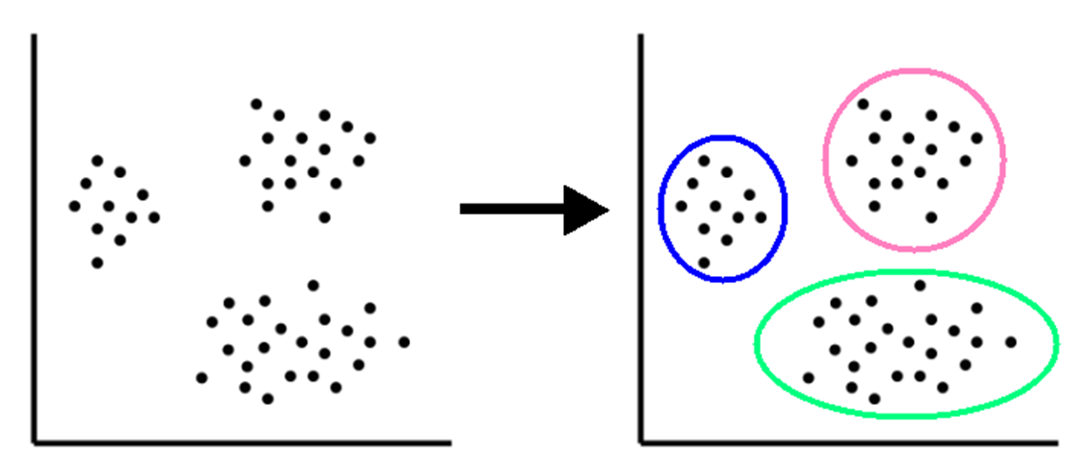
Unsupervised Learning
Objective: Use unlabeled data X to discover data patterns or structures that help solve clustering or association problems.

Slide 10
Supervised learning
Objective: Use labeled datasets (X, Y) to train algorithms that classify data or accurately predict outcomes.

Slide 11
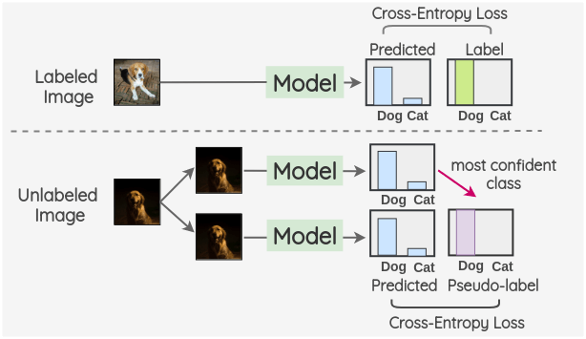
Semi-supervised Learning
Found between supervised and unsupervised learning

