Slide 1
Semi-supervised learning
Chapter 4

Slide 2
Outline
Definitions and applications
Semi-supervised learning problems
Methods for Semi-supervised learning

Slide 3
Introduction
Supervised learning: Use labeled datasets to train algorithms that accurately classify data or predict outcomes.
As input data is fed into the model, it adjusts its weights until the model has been fitted appropriately.
Unsupervised learning: Use unlabeled data to discover data patterns or structures that help solve clustering or association problems.

Slide 4
Introduction
Labeled Data: These data points have been explicitly tagged with a target variable or output, indicating the correct answer.
E.g.: Sign or road images for auto-driving.
Hand-written letters or digits for character recognition.
Unlabeled Data: These are data points that lack explicit labels or annotations. They don’t have corresponding outputs or target variables.
E.g.: only data vectors of any object (flowers, temperature, etc.)

Slide 5
Introduction

Slide 6
Introduction
Problems:
Usually a lot more unlabeled data is available than labeled.
Supervised learning requires domain expertise to label data appropriately, which can be time-consuming and costly.
Labeled data is much cheaper.
Semi-supervised learning = supervised + unsupervised learning.

Slide 7
SSL Techniques
Semi-supervised learning (SSL) occurs when only part of the given input data has been labeled.
Can we use unlabeled data to improve the learning models using a small labeled sample?
Self-Training
Co-Training
Multi-view Learning
Graph-based Label Propagation
Transfer Learning

Slide 8
SSL Applications
Text and Speech Recognition
Image recognition and classifications
Protein sequence detection
Customer modeling

Slide 9
SSL Techniques
Notations:
Training dataset: L (labeled data)
Unlabeled data: U
Models: M.
Pseudo label: Unlabeled data (from U) predicted by the model M during the training.

Slide 10
Pseudo-Labeling
Pseudo-labeled data can be converted into a “one-hot” label. E.g.
The most confident class becomes the label.
Confidence measure: ensemble models to vote the final class.

Slide 11
Self-training methods
Self-Training: The algorithm uses the labeled data to predict the unlabeled data with high confidence. These predictions are then added to the labeled dataset, expanding the labeled set.
Build a training model M to classify labeled data from L.
Predict a small group of U using M and output pseudo-labeled data
Choose pseudo-labeled data with high confidence and update L.
Repeat the previous steps.

Slide 12
Self-training methods

Slide 13
Self-training methods
We need to ensure sufficient data of each class for training models.
Adding pseudo-labeled data may decrease the performance.
The training process must be repeated several times, and the complexity becomes more expensive.

Slide 14
Labwork
Select 20% of data in a dataset as the training set, consider that 80% of remaining data are unlabeled.
Build different classification methods (k-nn, decision tree, or svm).
Predict unlabeled data and obtain the pseudo-label, calculate the quality performance.
Add pseudo-labeled data into the training dataset.
Only high-confident data is added,
E.g. in a k-nn, > 80% neighbors have the same label; or in Random Forest, >80% trees vote for the same label.
Repeat the process again.
Compare the performance after and before the pseudo-label addition.

Slide 15
Co-Training methods
Co-Training: Each classifier in co-training uses a unique view of the data.
Each data sample can be described by two distinct views and feature sets that provide separate yet complimentary information regarding the sample.
Multiple models can be used (usual 2 or 3).

Slide 16
Co-Training methods
Example: A dataset where each data sample has image data and audio data.
Train the models on audio data and image data separately. Then, you combine the two models to label the unlabeled data.
Reference: “Cooperative Learning of Audio and Video Models from Self-Supervised Synchronization”

Slide 17
Co-Training methods
Train two classifiers (M1 and M2) using a small amount of labeled data.
Unlabeled data is added to receive pseudo-labels.
Co-train two models using pseudo-labels with the highest confidence level.
Find non-matching pseudo-labels provided by two models.
Repeatedly update M2 with highly confident label data assigned by M1, or vice-versa.
The final step involves combining the predictions from the two updated classifiers to get one classification result.

Slide 18
Co-Training methods

Slide 19
Labwork
Split the data features into two subsets.
Select 20% of data in a dataset as the training set, consider that 80% of remaining data are unlabeled (Sub 1 and Sub2)
Build at least two different models (M1 and M2) for the training set using each feature subset.
Use M1 to predict a small amount of unlabeled data and obtain the pseudo-labeled data.
Add pseudo-labeled data to Sub 2 to train M2.
Use M2 to predict a small amount of unlabeled data and obtain the pseudo-labeled data.
Add pseudo-labeled data to Sub 1 to train M1.
Repeat.

Slide 20
Label Propagation
Use a small amount of labeled data to annotate unlabeled data with respect to the supervised models.
Principles are similar to k-nn.
Greedy approach
Unlabeled data that is similar to labeled data should share the same label.

Slide 21
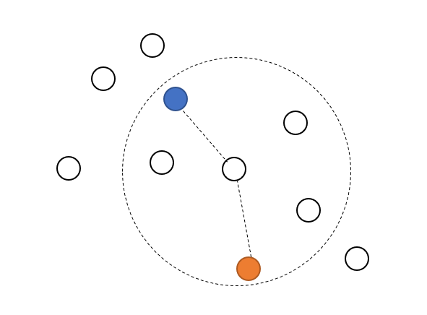
Label Propagation
Calculate the similarity
to decide the pseudo-label
for unlabeled data.
Graph-based models

Slide 22
Label Propagation

Slide 23
Label Propagation
Graph generation:
Minimum Spanning Tree
Greedy Algorithms

Slide 24
Label Propagation
Minimum Spanning Tree
The cost of the spanning tree is the sum of the weights of all the edges in the tree.
Minimum spanning tree is the spanning tree where the cost is minimum among all the spanning trees.
The total cost can be accumulated based on the spanning paths.
There also can be many minimum spanning trees.
Prim’s
Kruskal’s

Slide 25
Label Propagation
Minimum Spanning Tree
Graph-based models.
Adaptive for clustering and classification.
Apply for numerical data.

Slide 26
Label Propagation
Sample MST for the Iris dataset:
connectivity between pairs of objects
Connectivity between k-nearest neighbors

Slide 27
Conclusion
SSL maximizes the utility of the limited labeled examples.
SSL reduces costs by capitalizing on abundant unlabeled data, making it a cost-effective approach compared to fully supervised alternatives.
SSL promotes robust learning, allowing models to perform well on real-world scenarios.

Slide 28
Conclusion
SSL is sensitive to noise within the unlabeled data.
If the unlabeled dataset contains inaccuracies or irrelevant information, the model’s performance may be adversely affected.
The SSL effectiveness often relies on a small set of labeled data. If these examples are not representative of the entire dataset, the model may struggle to generalize accurately.
Developing effective SSL models requires intricate design and training procedures.

